Slide 1
Corona Virus Analysis

Slide 2
Corona Virus Analysis Adenugba oluwajuwon mentorness internship Batch Name: MIP-DA-09

Slide 3
Project overview
The CORONA VIRUS pandemic has had a significant impact on public health and has created an urgent need for data-driven insights to understand the spread of the virus.
This research project aims at analysing a CORONA VIRUS dataset using SQL to derive meaningful insights and present the findings.

Slide 4
Dataset overview
78386 Rows
Columns:
Province
Country/Region
Latitude
Longitude
Date
Confirmed
Deaths
Recovered
Start date: 2020-01-22
End date: 2021-06-13
18 Months of data available

Slide 5
Data Cleaning
Taiwan* → Taiwan
Date entries were standardized
Appropriate datatypes were assigned
No null entries discovered

Slide 6
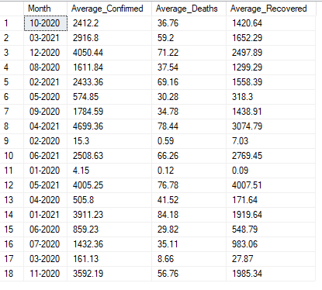
Data Analysis
Monthly average for confirmed cases, deaths, and recoveries

Slide 7
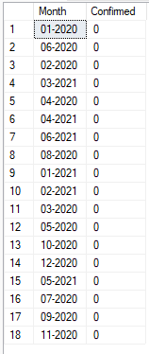
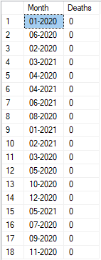
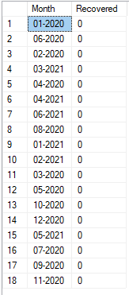
Data Analysis
Most frequent value for confirmed cases, deaths, and recoveries each month

Slide 8


Data Analysis
Minimum values for confirmed cases, deaths, and recoveries each year
Maximum values for confirmed cases, deaths, and recoveries each year

Slide 9
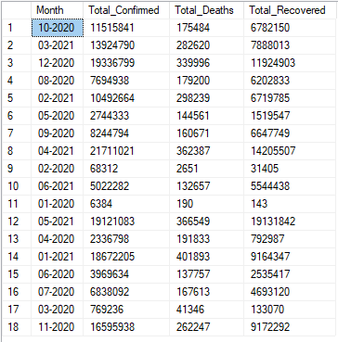
Data Analysis
Total number of confirmed cases, deaths, and recoveries each month

Slide 10

Data Analysis
Statistical spread of corona virus confirmed cases data
Statistical spread of corona virus recoveries data

Slide 11
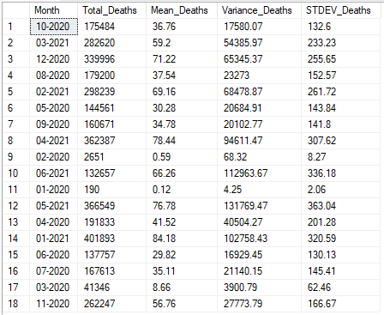
Data Analysis
Statistical spread of corona virus deaths data per month

Slide 12


Data Analysis
Country with highest number of confirmed cases
Country with lowest number of deaths

Slide 13
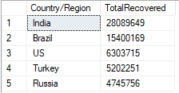
Data Analysis
Top 5 countries with highest recoveries

Slide 14
Conclusion
This data analysis project uncovered valuable insights to support decision making with regards to the corona virus pandemic.
Hope you found it insightful.
Drop you questions and comments
Thank YOU!!!

